Slide 1
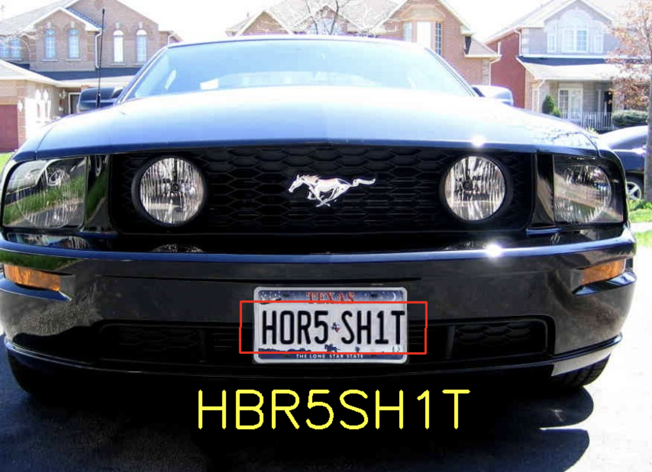
License Plate Character Recognition
Vritangi Kansal
Sarthak Awasthi
The project aims to detect the vehicle license plate, segment the characters on that plate, and identify each using a KNN algorithm. All these steps involve some traditional computer vision techniques. The main function takes an image as input and displays the corresponding characters on the car plate as the output.

Slide 2
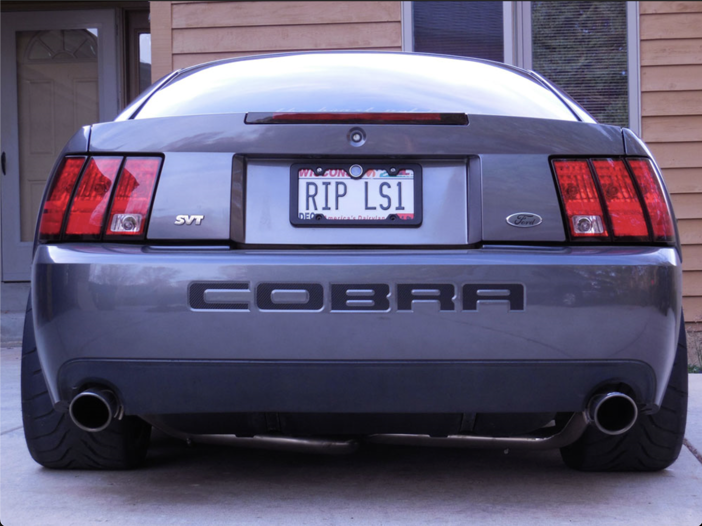
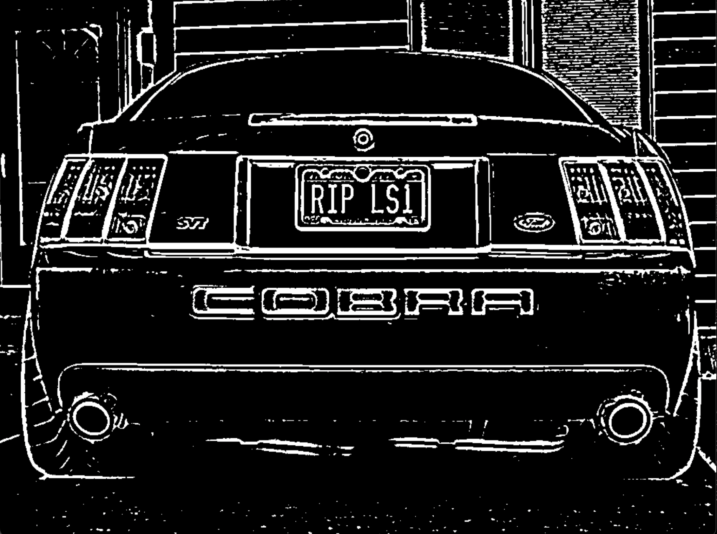
Framework: Pre-Processing
Data: A random assortment of publicly available images containing vehicles with license plates in different online locations.
Pre-processing the image using gray-scaling and Canny edge detection.
Use morphological operators (opening/closing) to remove noise in the image.
Original Image
Thresholding results after pre-processing

Slide 3
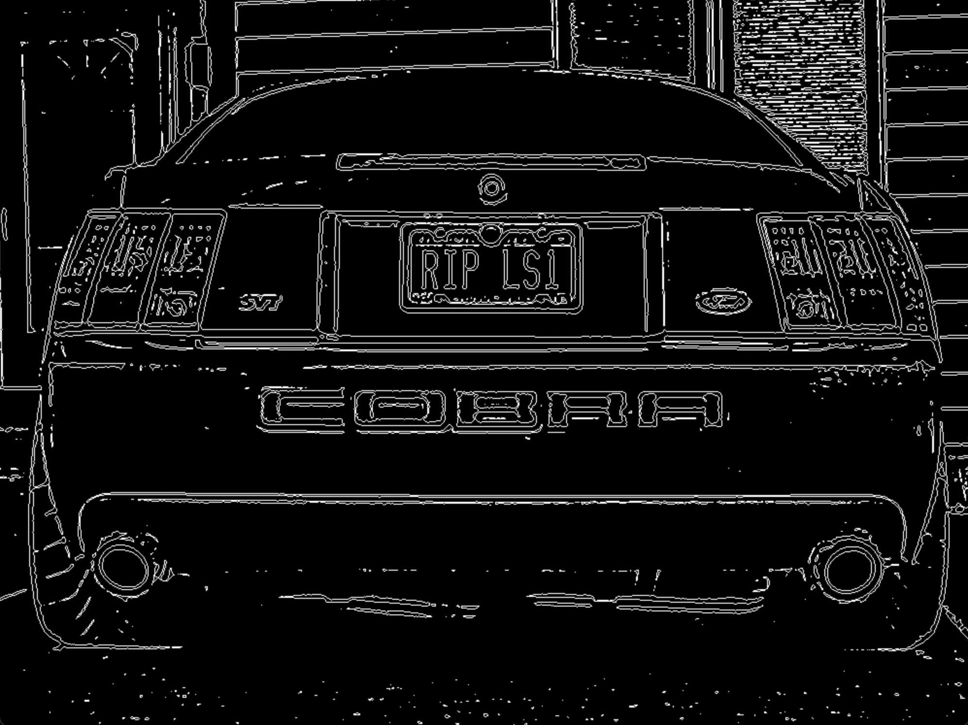
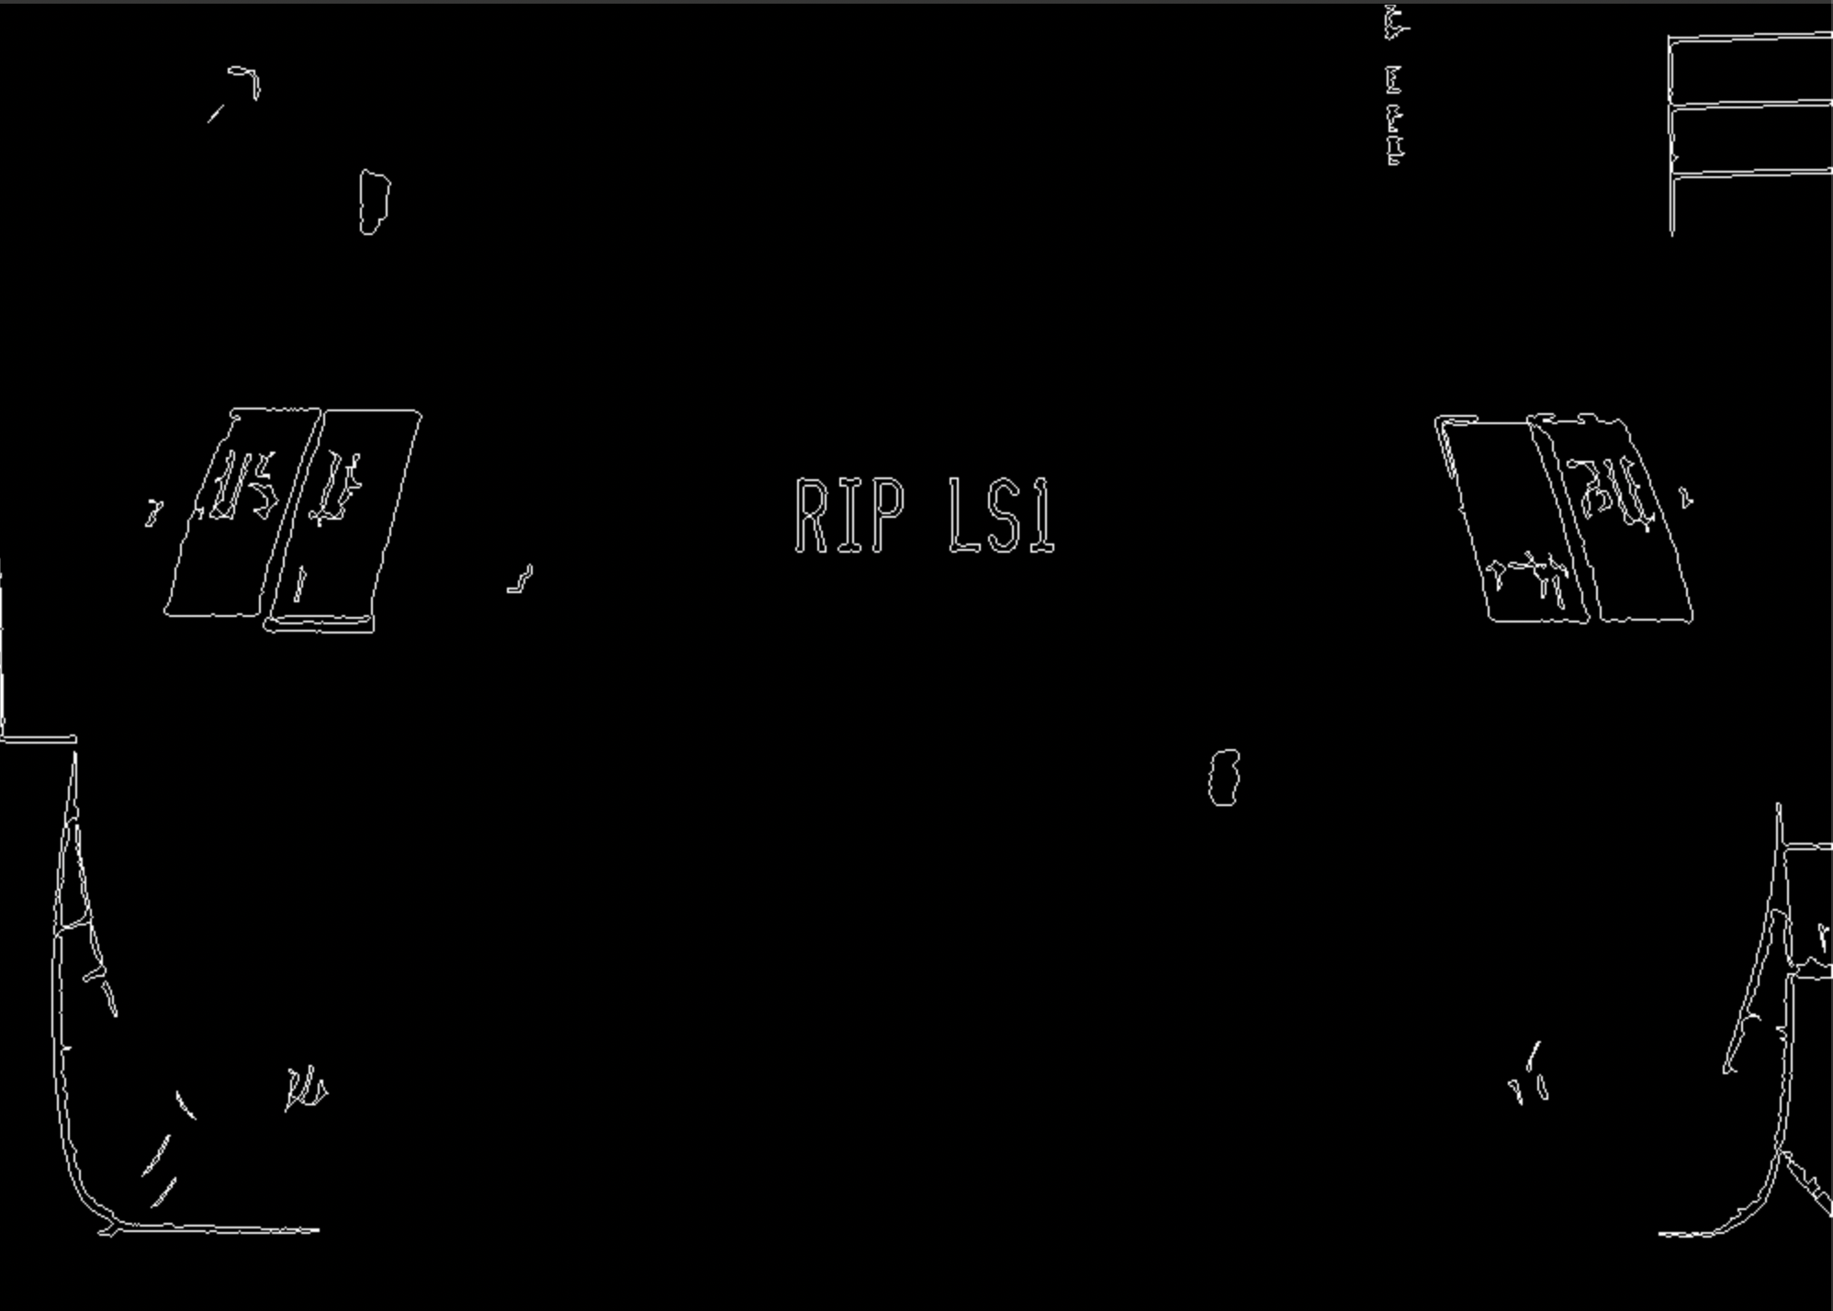
Detecting License Plate
Find closed components(contours):
Identify the contours that may be possible characters:
Count: 1082
Count: 49
This is done by hyper-tuning the parameters such as setting min-max values for pixel width, height, aspect ratio, area.

Slide 4
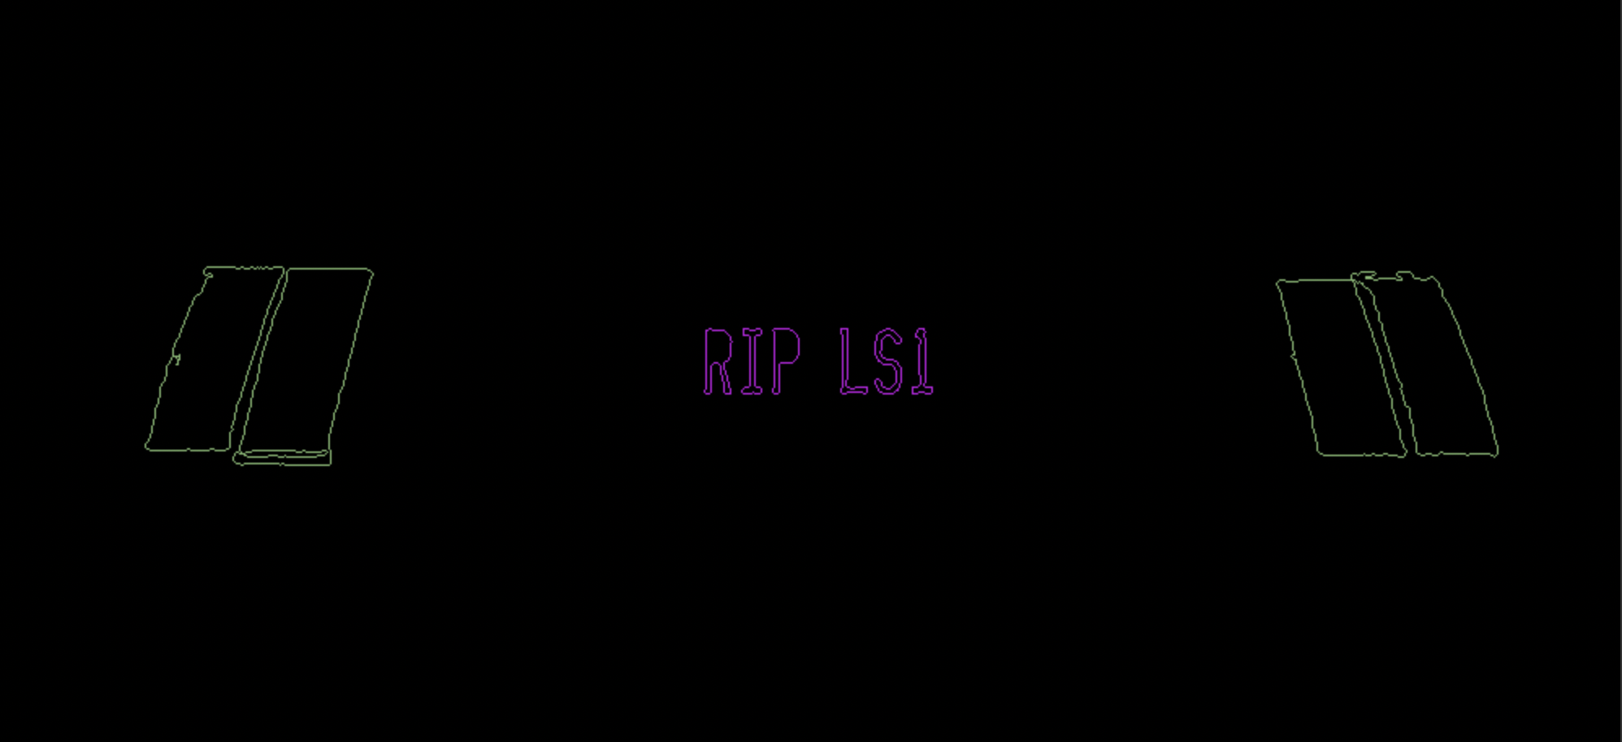
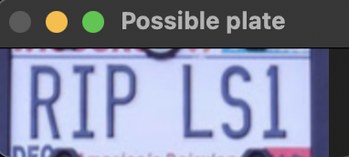
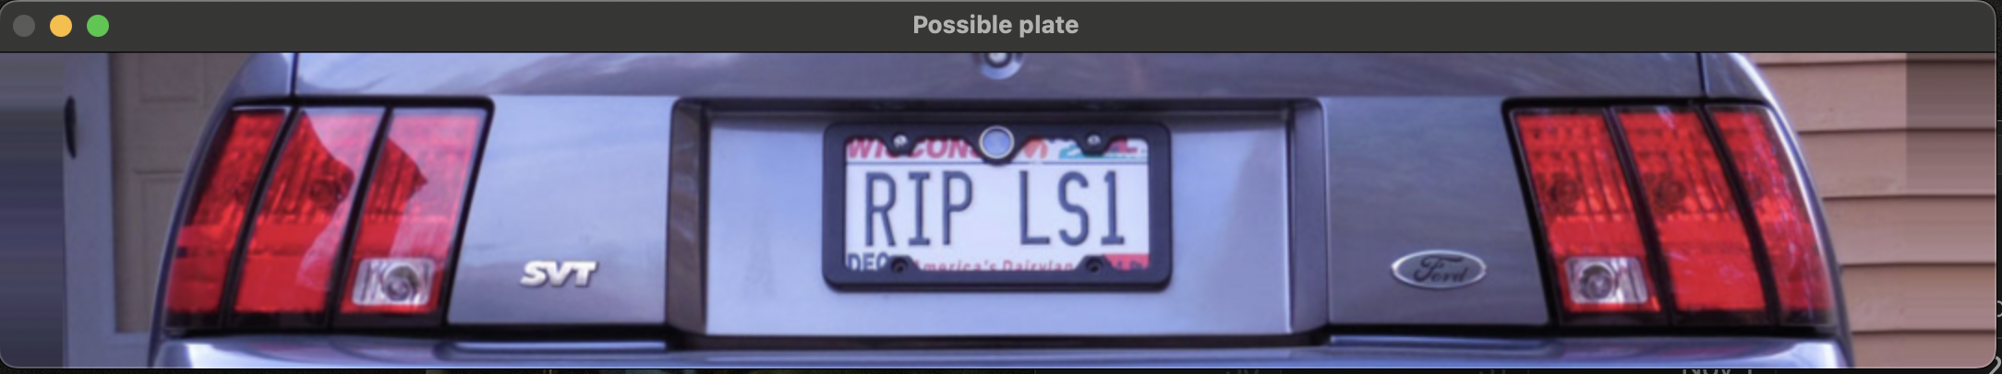
Find the string of characters closer to each other and group them:
Count: 2
Extract Potential License Plates:

Slide 5


Segment Characters
Pre-processing the possible plates by gray-scaling, Gaussian blurring, and thresholding.
Find connected components having character-like features for every possible plate by setting dimensional constraints for possible characters.
Segment each character by finding its bounding box.

Slide 6
Classification & Character Recognition
Each character acts as an input into the KNN classifier (K=1) to find the nearest character and classify it accordingly.
Perform the same loop for all characters.
This is done by assigning a class to 36 different alphanumeric characters consisting of 26 letters and 10 digits. All these characters of different contours are used as a training set of standard font.

Slide 7
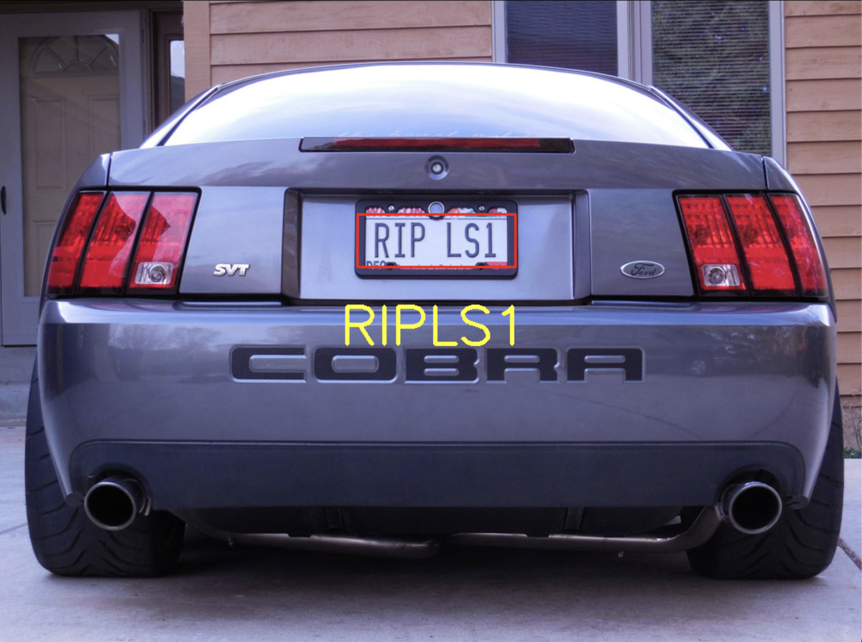
Contribution
Vritangi: preprocessing functions and detection of license plate
Sarthak: segmentation of characters, classification using KNN
Results

Slide 8
Evaluation Of Results
Total Image Set: 35
Accurate detections: 28
Accurate License Plate Detection: 31
Accurate Character Recognition: 28

Slide 9
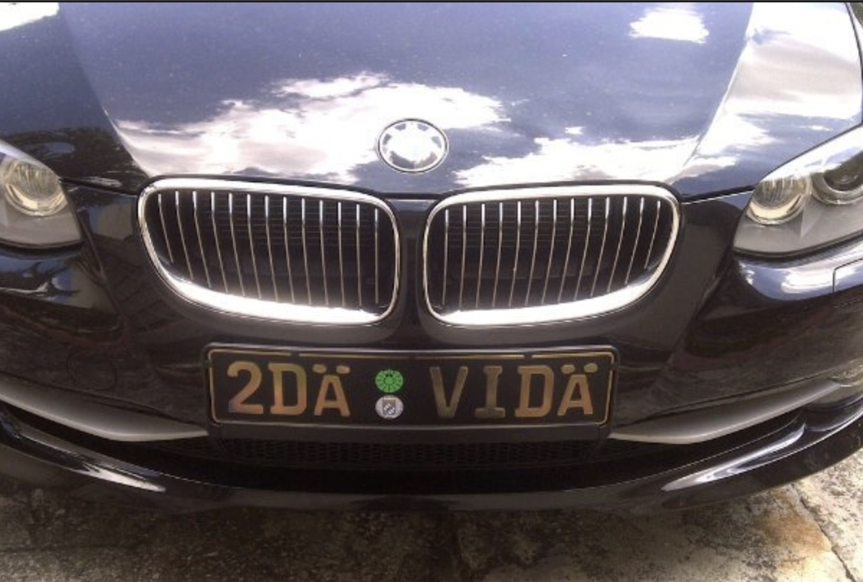

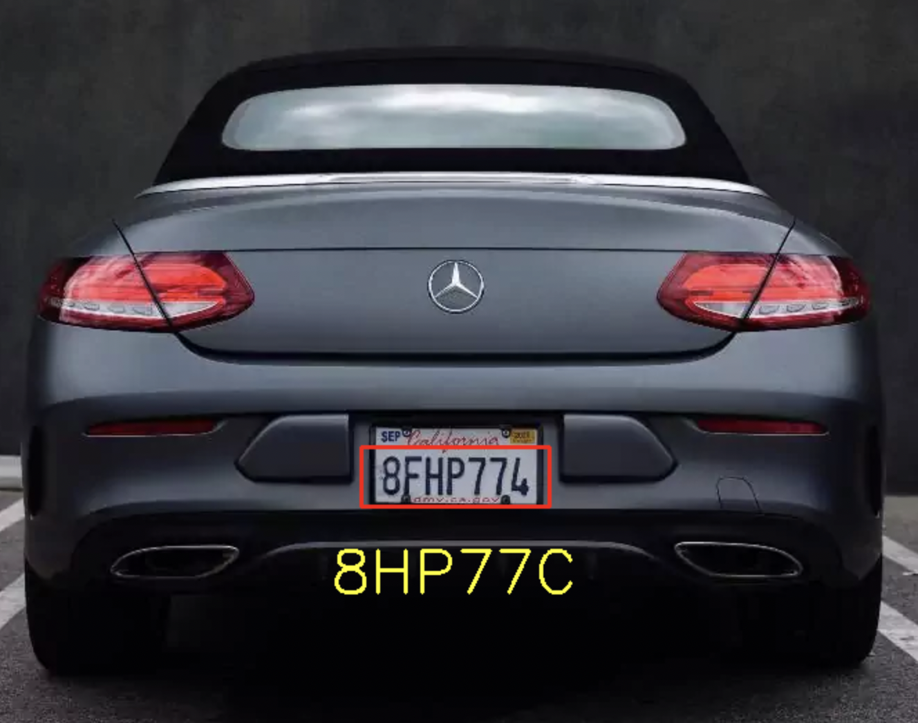
Problems Encountered
Thresholding failing for images where contrast difference is not high between background and foreground.
Closed component detection failing for certain characters in License Plate.

Slide 10
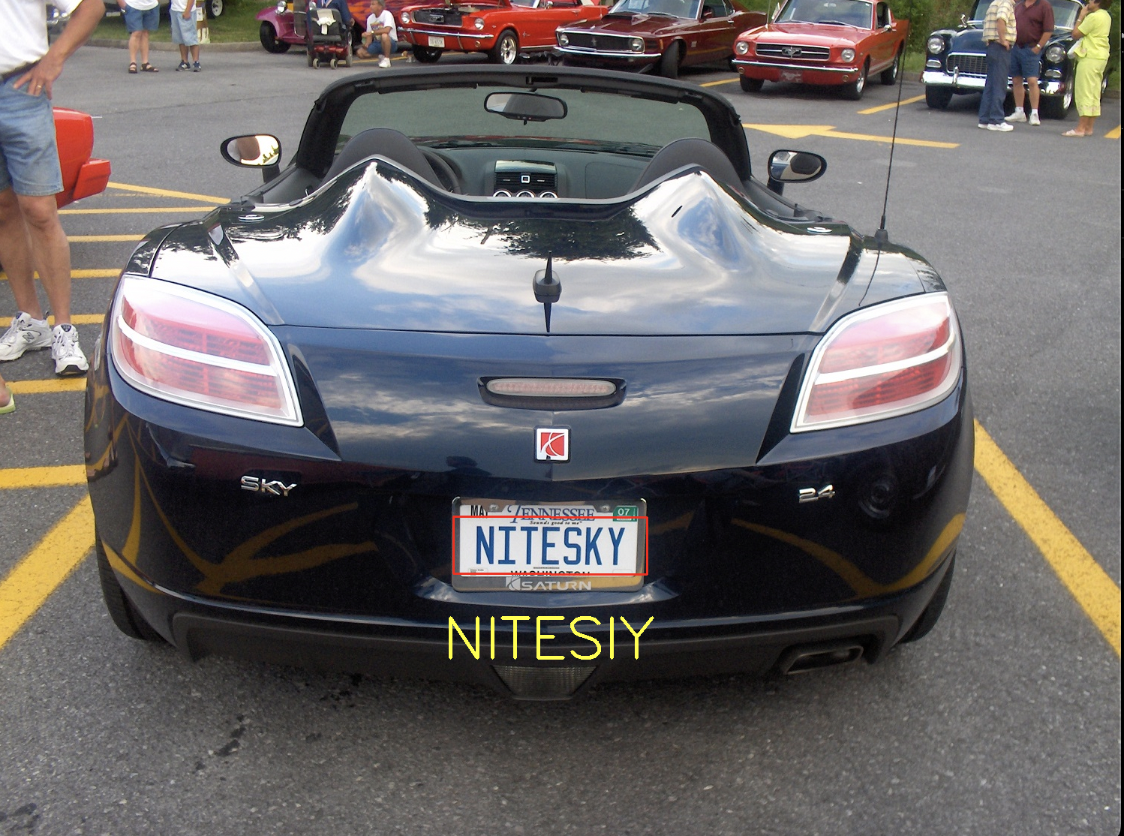
Some characters might not be recognized correctly.

Slide 11
Lessons learned
Image quality needs to be sufficiently high to detect characters.
Applying preprocessing techniques solves a lot of issues regarding noise and background
Hyper parameter tuning(optimization) for a dataset can really improve results but at the same time it might not work for all the use-cases.

Slide 12
What else could be done (if you had more time)?
Current implementation doesn’t work on tilted images with varied camera angles.
Improve plate detection which can include other factors like plate background/texture/natural light etc.
Include motion blurred effect due to fast-paced vehicle.
Extracting frames from a video to perform the same algorithms.
Look for better techniques to solve the problems mentioned above.

